Slide 1























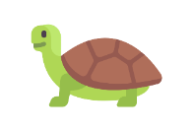



Dive into Open Source
Exploring the Ocean of Open Source
With Mozilla Punjab

Slide 2
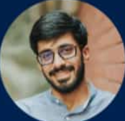





Web Components
For Microfrontends & Reusable Components
@karx
Founder, Akriya Technologies
<talk-intro>
Want to build a re-usable input tag?
Want to build an embeddable char widget?
Or you just want a customizable video tag?
Web Components – a recipe for all!
</talk-intro>

Slide 3

A head start to Mobile Development
@ORePoala
Mobile App Developer
“Want to get into Mobile Development, but intimidated by the vast ocean ahead of you? Can’t decide whether to go for Native Development or React Native or Flutter?
Or do you also wonder if Android (or iOS) development are the only field in mobile market to get into? Here’s a session to guide you and help you choose which way to go!”

Slide 4
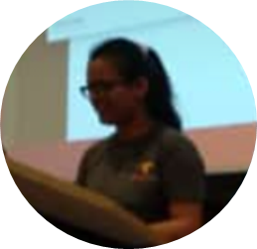
Localization with Pontoon
@soniasingla
Localisation Contributor Mozilla
“Want to learn, know and use the computer and advanced technologies in your own local ethnic language? So let’s catch-up and break this language barrier. “

Slide 5
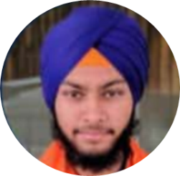


Introduction to
VR(Aframe.io) & AR(AR.js)
@suhailsinghbains
Representative, Mozilla
“Stay relevant to the market for next 20-30 years. Add webVR to your Resume now. In the Session, we will dive into Open Source Project Aframe.io and discuss the career path you can take with VR.”

Slide 6

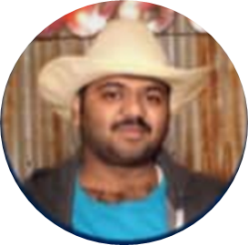



Getting Started with Open Source
@lamvp7
Mozilla Tech Speaker
Mozilla Reps
“Get to know how student got converted himself as an Open Source contributor. Learn what he learned through his journey as App Reviewer, Evangelist and Community Coordinator.”

Slide 7
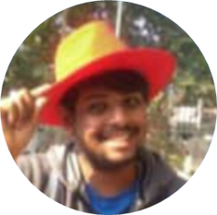

Kotlin/Native
Magic of Shared Code
@theLimitBreaker
Google Certified Associate Android Developer
“Leveraging the power of Kotlin Language to support multi-platform and sharing code (business logic) among multiple platforms. For companies targeting their product on multiple platform is quite big task, But Business logic is same. So why repeat the business logic on every platform. With Kotlin/MultiPlatform and Kotlin/Native you follow code common and respect the Platform.”

Slide 8
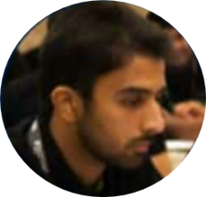
Design the Open Source way
@iamtanzeelkhan
Reps Mentor, Mozilla
“Creating graphic design with open source tools works, and the tools look similar to the expensive tools we know. The Biggest impediment to switching is lack of awareness and assumed file incompatibility. In this session we will discuss the fundamentals of Design, typography, color and the tools available for graphic design.”

Slide 9
Two-Day Event
23rd & 24th March
With an Aim to provide you a basic Training by organizing Hands-on Session on
Various technology during the Session.
10 AM - 4 PM
Lovely Professional University
Venue: Block 25-101

Slide 10
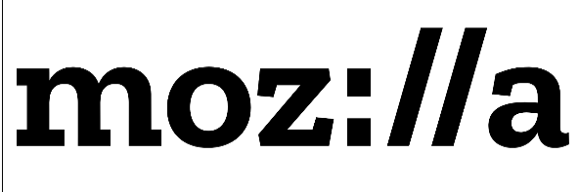
punjab

